Slide 1





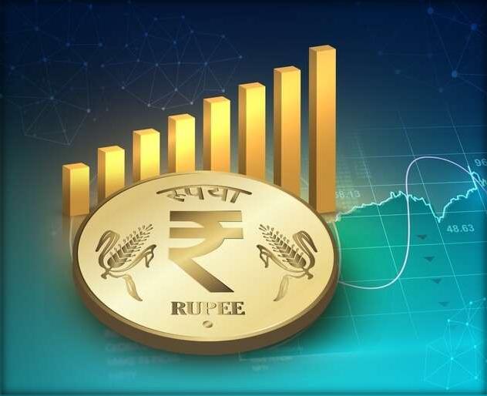
Key Features Of Union Budget 2024-2025
◤
◤
Made By:- Group 6
Ashwin Dhumal
Athulya Manapurath
Kritika Pradhan
Ratnesh Singh
Ayushi Sinha
Sudhanshu Sharma
Abhishek Tripathi

Slide 2
MACRO OUTLINE
Budget Analysis 2024-25
◤
Overview of the Budget
Key macroeconomic indicators (GDP growth, inflation, etc.)
Fiscal stance
(revenue, expenditure, deficit)
Major policy announcements and priorities
Revenue Analysis
Fiscal Management
Direct taxes
Indirect taxes
Fiscal deficit and debt sustainability
Medium-term fiscal framework
Expenditure Analysis
Public Financial Management
Reforms
Capital expenditure
vs. revenue expenditure
Plan vs. non-plan expenditure
Expenditure management reforms
Revenue administration reforms

Slide 3
MACRO
◤
Challenges and Opportunities
Economic outlook and risks
Fiscal challenges (revenue
shortfall, expenditure pressures)
Opportunities for revenue mobilization
and expenditure rationalization
Impact of global economic trends
Evaluation and Recommendations
Assessment of budget performance
Policy implications and recommendations
Suggestions for future budgets

Slide 4



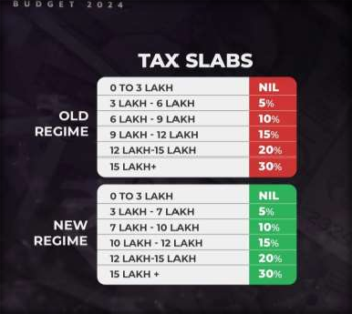
Taxation
◤
◤
The standard deduction for salaried employees is increased from ₹50,000 to ₹75,000 for those opting for the new tax regime.
The deduction on family pension
for pensioners was enhanced from
₹15,000 to ₹25,000.
Short-term capital gains on specified financial assets shall be taxed at a rate of 20% instead of the previous rate of 15%.
Long-term gains on all financial and non-financial assets will attract a tax rate of 12.5%.

Slide 5
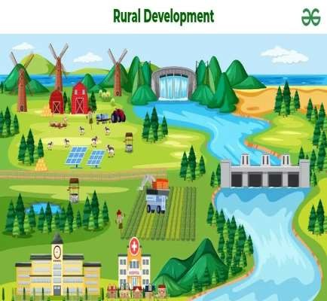


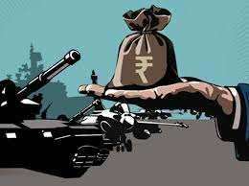

SECTORS
Agriculture- The Budget 2024-25 has made a provision of ₹ 1.52 lakh crore for agriculture and allied sector.
Rural Development- The budget provides an allocation of ₹2.66 lakh crore for rural development, including rural infrastructure projects.
Defense- In the Regular Union Budget of Financial Year (FY) 2024-25, Ministry of Defense (MoD) has been allocated Rs
6.21 lakh crore.

Slide 6


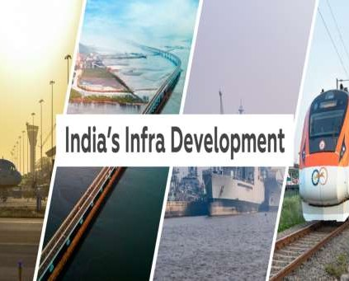


Infrastructure- ₹11,11,111 crore (3.4% of GDP) was allocated for capital expenditure to support infrastructure development.
Commerce & Industry- In the Union Budget
2024-25, the Indian government allocated
₹47,559 crore to the Ministry of Commerce and Industry.
Employment and Skilling- The Union Budget 2024-25 of India places a significant emphasis on employment and skilling initiatives with a comprehensive allocation of ₹1.48 lakh crore.

Slide 7
Budget Provision
◤
AGRICULTURE
Provision of Rs. 1.52 lakh crore for agriculture and allied sectors this year.
Transforming Agriculture
Research
A comprehensive review of the
agriculture research setup.
Focus on raising productivity and developing climate-resilient varieties.

Slide 8

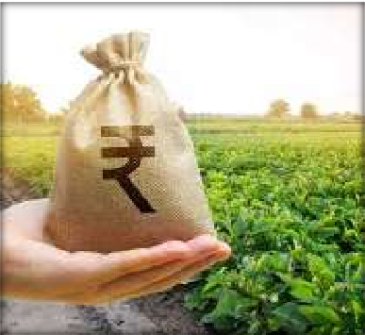
Agriculture
◤
Release of New Varieties
Release 109 high-yielding and climate-resilient varieties of 32 field and horticulture crops for farmers.
Natural Farming
Initiate one crore farmers into natural farming over the next two
years.
Support through certification and branding.
Implementation by scientific institutions and willing gram panchayats.
Establish 10,000 need-based bio-input resource centres.
Missions for Pulses and Oilseeds
Strengthen production, storage, and marketing of pulses and oilseeds.

Slide 9

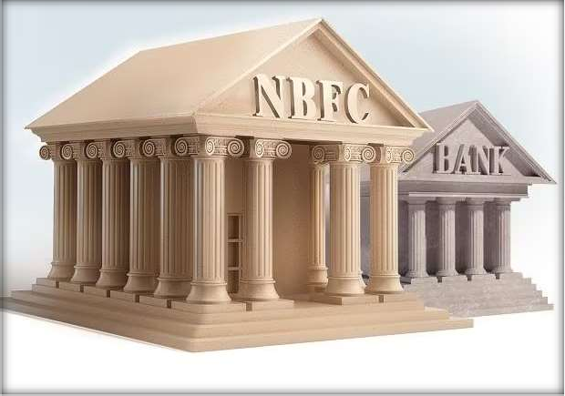
Banking & NBFCs
◤
◤
Public sector banks to build in-house capability for credit assessment of MSMEs, says FM Sitharaman.
There was no mention in the Budget of reduction of the SARFAESI limit for NBFCs.
The objective for the budget deficit has been decreased to 4.9% of GDP, with the intention of bringing it further lower by FY2025–2026. This is anticipated to be advantageous for NBFCs and banks in the
public sector, possibly resulting upgrading of India's sovereign The budget has increased the
in an rating. amount
allotted to Mudra loans for borrowers who are good borrowers by two times, from ₹1 million to ₹2 million. This policy seeks to assist entrepreneurs and small enterprises.

Slide 10

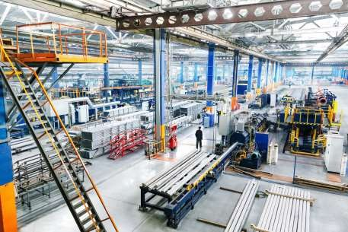


MANUFACTURING
◤
Good Governance and Fiscal Prudencex
Employment and Incentive Programs
Support for MSMEs and Startups
Support for MSMEs and Startups
Tax Reforms to Boost Domestic
Manufacturing

Slide 11




◤
INCREASED INVESTMENTS IN DIGITAL INFRASTRUCTURE AND AI INTEGRATION
POLICIES SUPPORTING SUSTAINABLE PRACTICES AND GREEN INCENTIVES
POTENTIAL OPPORTUNITIES AND CHALLENGES FOR MANUFACTURERS
NAVIGATING REGULATORY CHANGES AND COMPLIANCE COMPLEXITIES

Slide 12

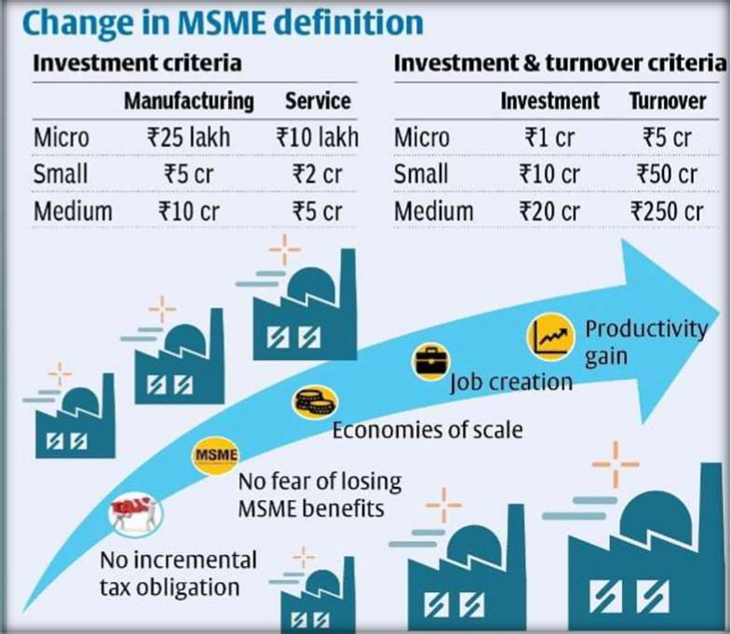
MSME SECTOR
◤
The Union Budget for 2024- 2025 has introduced several measures to support Micro, Small, and Medium Enterprises (MSMEs) and the labor- intensive manufacturing sector.
The Budget 2024-25 has proposed a new credit guarantee scheme to facilitate term loans for MSMEs to purchase machinery and equipment without requiring collateral or third-party guarantees.

Slide 13


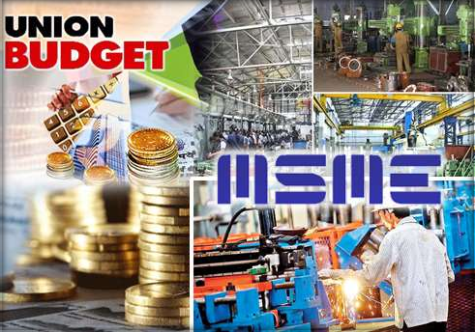


MSME
◤
The Mudra loan limit has been increased to Rs 20 lakh from the current Rs 10 lakh for entrepreneurs who have successfully repaid previous loans under the ‘Tarun’ category.
Efforts will be made to facilitate the setup of 100 food quality and safety testing labs with NABL accreditation.
This scheme also establishes a self- financing guarantee fund that pools credit risks, providing coverage up to ₹100 crore per applicant.
Borrowers pay minimal upfront and annual fees based on the reducing loan balance, making credit more affordable.

Slide 14


RETAIL
◤
For the India’s retail industry, one looks forward to individual and institution incentives in the form of reduced taxes, which could spur higher demand in consumption and provide a fillip to the economy.
For instance, the GST rates for many retail products vary between 28% and 5%. Given that most of these items are used regularly by consumers, reducing the overall GST slabs or adding another tax slab will increase affordability.

Slide 15

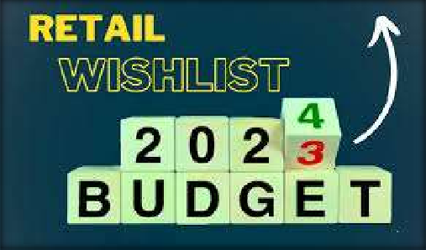
The Retail Segment has many potential drivers.
◤
By 2026, the retail market is anticipated to reach $1.41 trillion, propelled partly by more than 900 million projected internet users by 2025 2, giving a boost to retail segments.
In the past year, consumer spending
has remained resilient, reflecting
economic
positive sentiment and
activity.
In this context, implementing appropriate tax incentives can further
boost the retail industry, especially
small traders, by extending their
operational capacity.
This would benefit both traditional and modern retailers, fostering growth and innovation across the sector.

Slide 16

Telecom & Information Technology
◤
◤
In the Union Budget for the financial year 2024-25, ₹1.28 lakh crore was allocated for telecom projects and public sector firms under the telecom ministry.
Of the total allocation, the majority of funds have been earmarked for BSNL and MTNL-related expenses.
BSNL (Bharat Sanchar Nigam Limited) would get ₹82,916 crore for technology upgradation and restructuring.
Ministry of Electronics and Information Technology (MeitY) has been allocated a budget of INR 21,936 crores as compared to INR 16,549 crore in the previous year.

Slide 17
THANK YOU

